Slide 1



Phishing Awareness Training
Empowering you with the knowledge and tools to identify, avoid, and report phishing attacks. This training will cover essential concepts, common tactics, and best practices to safeguard our digital lives.
by Soham Arte
Notes:
1

Slide 2
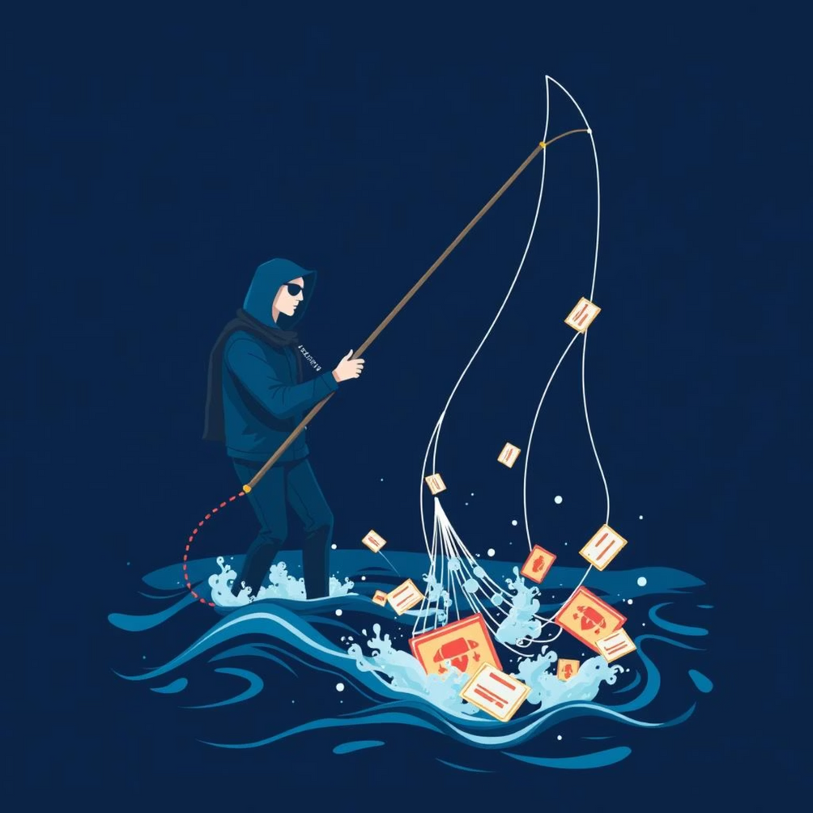
Understanding Phishing: The Digital Deception
Phishing is a type of cyberattack where malicious actors impersonate trusted entities to trick individuals into revealing sensitive information, such as usernames, passwords, credit card numbers, or other personal data.
The primary risk lies in unauthorized access to accounts, financial fraud, data breaches, and potential malware infections, which can compromise both personal and organizational security.
Notes:
2

Slide 3

Spotting Suspicious Emails: Key Red Flags
Urgent and Threatening Language
Be wary of messages demanding immediate action, threatening account closure, or promising unrealistic rewards.
Generic Greetings and Poor Grammar
Legitimate organizations typically use your name. Look out for glaring grammatical errors or awkward phrasing.
Suspicious Sender Addresses
Always check the sender's full email address. Phishers often use addresses that are slightly off or from unusual domains.
Malicious Links and Attachments
Hover over links to see the true URL. Never open unexpected attachments, especially from unknown senders.
Notes:
3

Slide 4





Identifying Fake Websites: Verify Before You Click
Incorrect URLs
Always check the website's URL for typos or unusual domains. Phishers often create fake sites with slightly altered addresses.
Unsecured Connections (HTTP)
Legitimate websites, especially those requiring logins, use "HTTPS" (with a padlock icon) for secure connections. Avoid "HTTP" sites for sensitive data.
Fake Logos and Design Flaws
Look for blurry logos, inconsistent branding, or poor design quality. Phishing sites often mimic legitimate ones but miss subtle details.
Suspicious Login Pages
Be cautious of login pages that appear unexpectedly or outside of a normal workflow. Always navigate directly to the official site.
Notes:
4

Slide 5

Social Engineering Tactics: The Human Element
Impersonation
Attackers pretend to be someone you know or trust, like a colleague, manager, or IT support, to gain your confidence.
Pretexting
Creating a fabricated scenario to engage the victim and obtain information under false pretenses.
Baiting
Offering something enticing, like a free download or a flash drive, to lure victims into a trap.
Scare Tactics
Using threats or alarming warnings to intimidate victims into immediate action without thinking.
Notes:
5

Slide 6


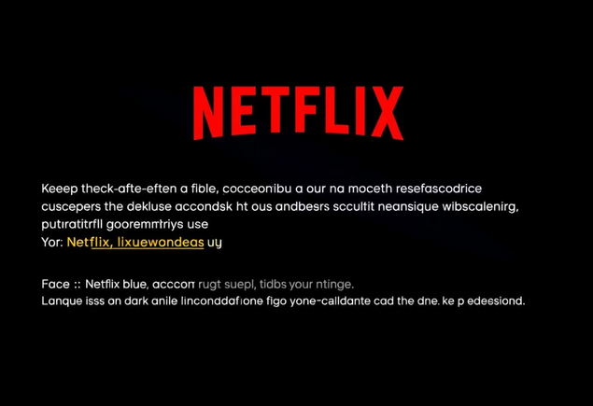
Real-World Phishing Examples: Lessons Learned
PayPal Impersonation
Amazon Delivery Scam
Netflix Account Suspension
A widespread phishing campaign used fake PayPal login pages to steal credentials. Users were directed to these convincing but fraudulent sites through deceptive emails.
Phishing emails disguised as Amazon delivery notifications often contain links to malicious websites that attempt to harvest personal and financial information.
Scammers send emails claiming Netflix accounts are suspended, urging users to "update" payment details via a fake link, leading to credential theft.
Notes:
7

Slide 7





Best Practices: Your Defense Against Phishing
Verify Sources
Always confirm the sender's identity and the legitimacy of links or attachments before interacting.
Don't Click Unknown Links
Avoid clicking on suspicious links directly. Instead, type the official website address into your browser.
Use Strong Passwords & MFA
Create complex, unique passwords and enable Multi-Factor Authentication (MFA) wherever possible.
Report Suspicious Activity
If you encounter a phishing attempt, report it immediately to the IT department and delete the email.
Notes:
8

Slide 8
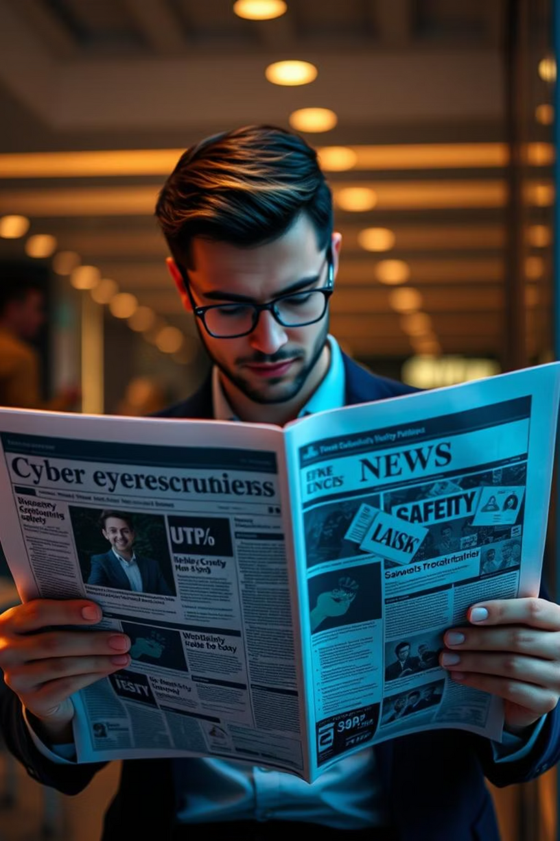
Conclusion : For Staying Safe Online
Think Before You Click: Always pause and evaluate the authenticity of emails and websites.
Verify, Verify, Verify: Double-check sender details, URLs, and any urgent requests.
Report, Don't Ignore: Reporting phishing attempts protects both you and the organization.
Keep Software Updated: Ensure your operating system and applications have the latest security patches.
Notes:
9

